Slide 1


Invincible Apps with Dapr
Paul Yuknewicz
Head of Product, Azure Serverless Microsoft Corporation
@paulyuki99
linkedin.com/in/paul-yuknewicz-50a91125/
Notes:
Good morning, everyone!
It’s great to be back at the Cloud + Containers conference at live360.
This is one of my favorite events, thank you so much for having me.

Slide 2
Doing more
+
2
with less
–
Notes:
We are going through a period of historic economic, societal and technological change. But for all the uncertainty we continue to see in the world, one thing is clear: organizations in every industry are turning to you to help them do more with less, so that they can navigate this change and emerge much stronger.
You are the change agents who make doing more with less possible – less time, less cost, less complexity, with more innovation, more agility and more resilience.
Doing more with less doesn’t mean working harder or longer.
It means applying technology to amplify what you can do, and ultimately, what an organization can achieve amidst today’s constraints.

Slide 3
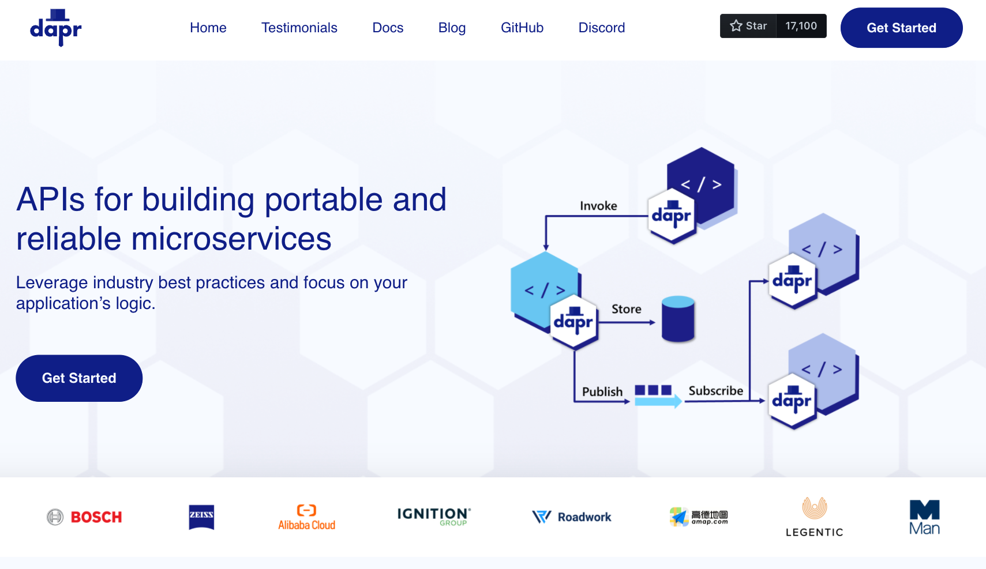

Slide 6
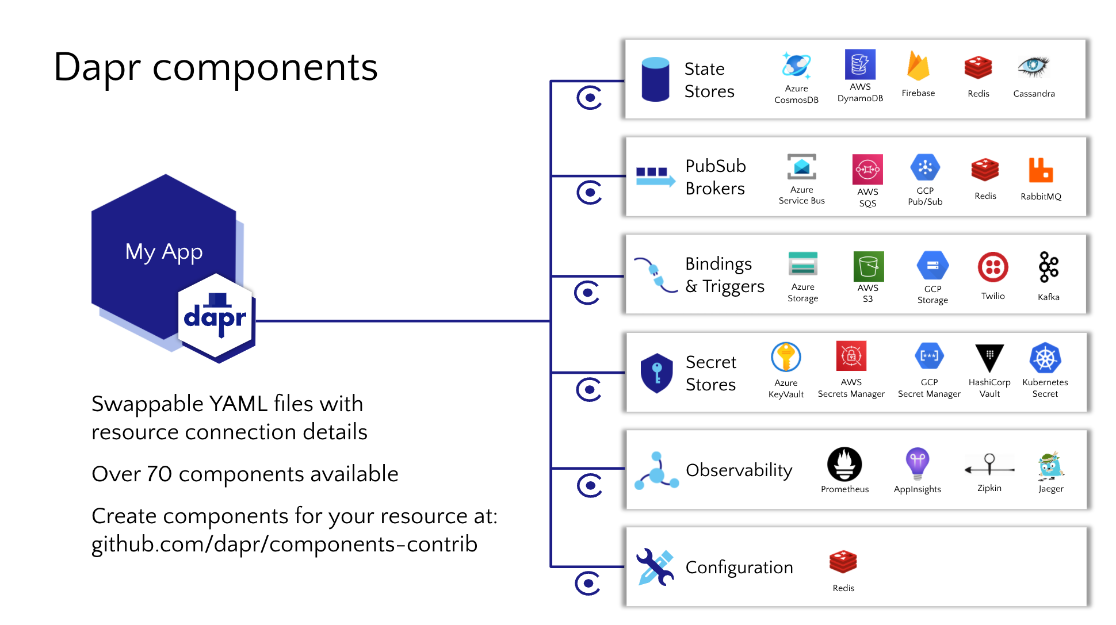
107

Slide 7
var order = new Order(100);
using var client = new DaprClientBuilder().Build();
// Publish an message using Dapr PubSub
await client.PublishEventAsync("order_pub_sub", "orders", order);

Slide 8
Event Driven Scaling KEDA + Dapr
Built-in scalers for multi vendor databases, messaging systems, metrics, CICD, and more.
Works alongside Kubernetes Horizonal Pod Autoscaler
Built-in to Azure Container Apps
Extensions for Azure Kubernetes Service
CNCF incubations project

Slide 10
DEMO
Lap around Dapr

Slide 11
Dapr Resiliency
with Azure Load Test and Chaos Studio
Notes:
Hi everyone,
it’s been roughly a year since the last MVP summit where I presented the Dapr resiliency capability. Back then the resiliency feature wasn’t yet available in the Dapr runtime and instead I showed some conceptual designs of how it would work prior to it be implemented.
But now, we have the feature available in the runtime and I’m here to show you how you can use Dapr resiliency to help you build what we call invincible microservice applications.

Slide 12







Placeholder for Image Content
Input
Binding
Publish & Subscribe
State
Management
resiliency
Trigger
Get state
v2
Publish
Output
Binding
Application Configuration
resiliency
resiliency
Get config
Subscribe
resiliency
resiliency
Call method
resiliency
resiliency
Retrieve secret
resiliency
Service
Invocation
Secret Management
Notes:
Most of us are probably well aware that microservices are gaining a lot of popularity and many developers who are looking to modernize applications are moving to a microservice architecture because of the numerous benefits –
- help reduce single points of failure
- allows for independent scaling and resource utilization,
- provides more flexibility with programming languages and technologies that can be used
But one challenge that’s introduced with microservices is the there are now a lot of moving parts, which increases the likelihood of something going wrong somewhere in the application. That’s why it’s crucial that distributed systems are built with fault-tolerance in mind so they can become self-healing in the event that an issue does occur.
Here we’re looking at a distributed-microservice based application that’s leveraging many Dapr building blocks. With the resiliency capability, I can make sure ever Dapr API call has resiliency behind it.

Slide 13
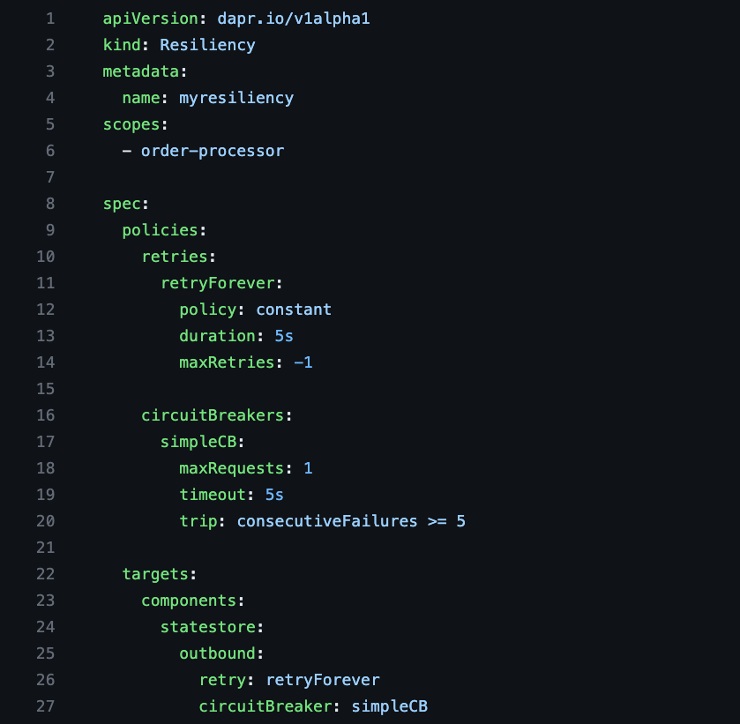
Dapr Resiliency
Resiliency patterns can be applied across all Dapr APIs
Retries/back-offs
Timeouts
Circuit breakers
Declarative and decoupled from application code
Available across all component types, service invocation and actors
Notes:
If we take a look at how resiliency works –
Dapr supports 3 resiliency policy types - retries/back-offs, timeouts, and circuit breakers
What is unique about Dapr resiliency is that it’s a declarative model meaning it’s configured and applied via a configuration which is completely decoupled from application code.
And lastly, as I mentioned earlier, it can be applied to all Dapr API target types – svc-to-svcs calls, calls to a component and actors.

Slide 14
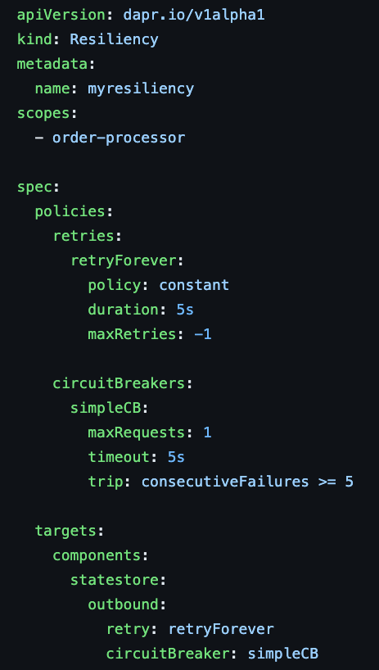


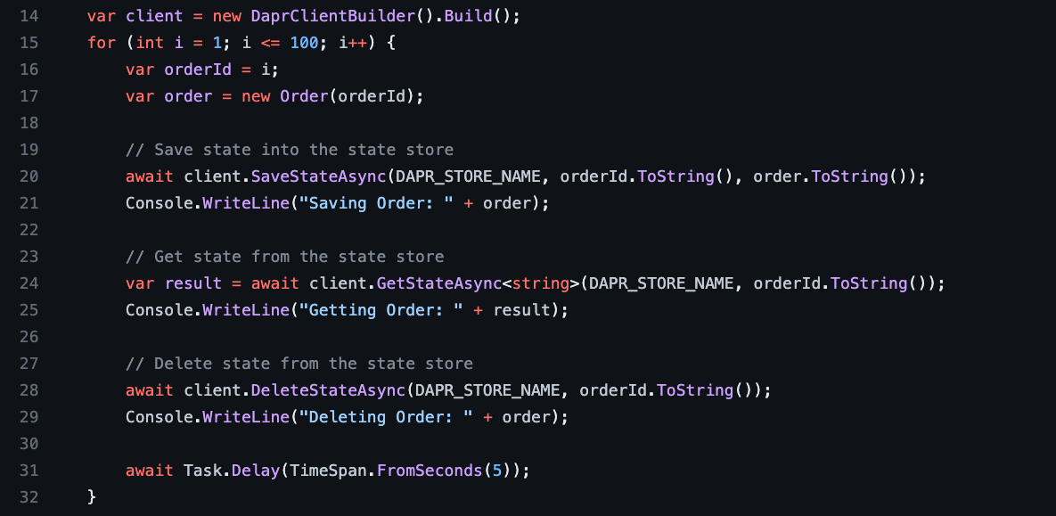
Placeholder for Image Content
Dapr Resiliency
Order
processor
Outbound
statestore

Slide 15
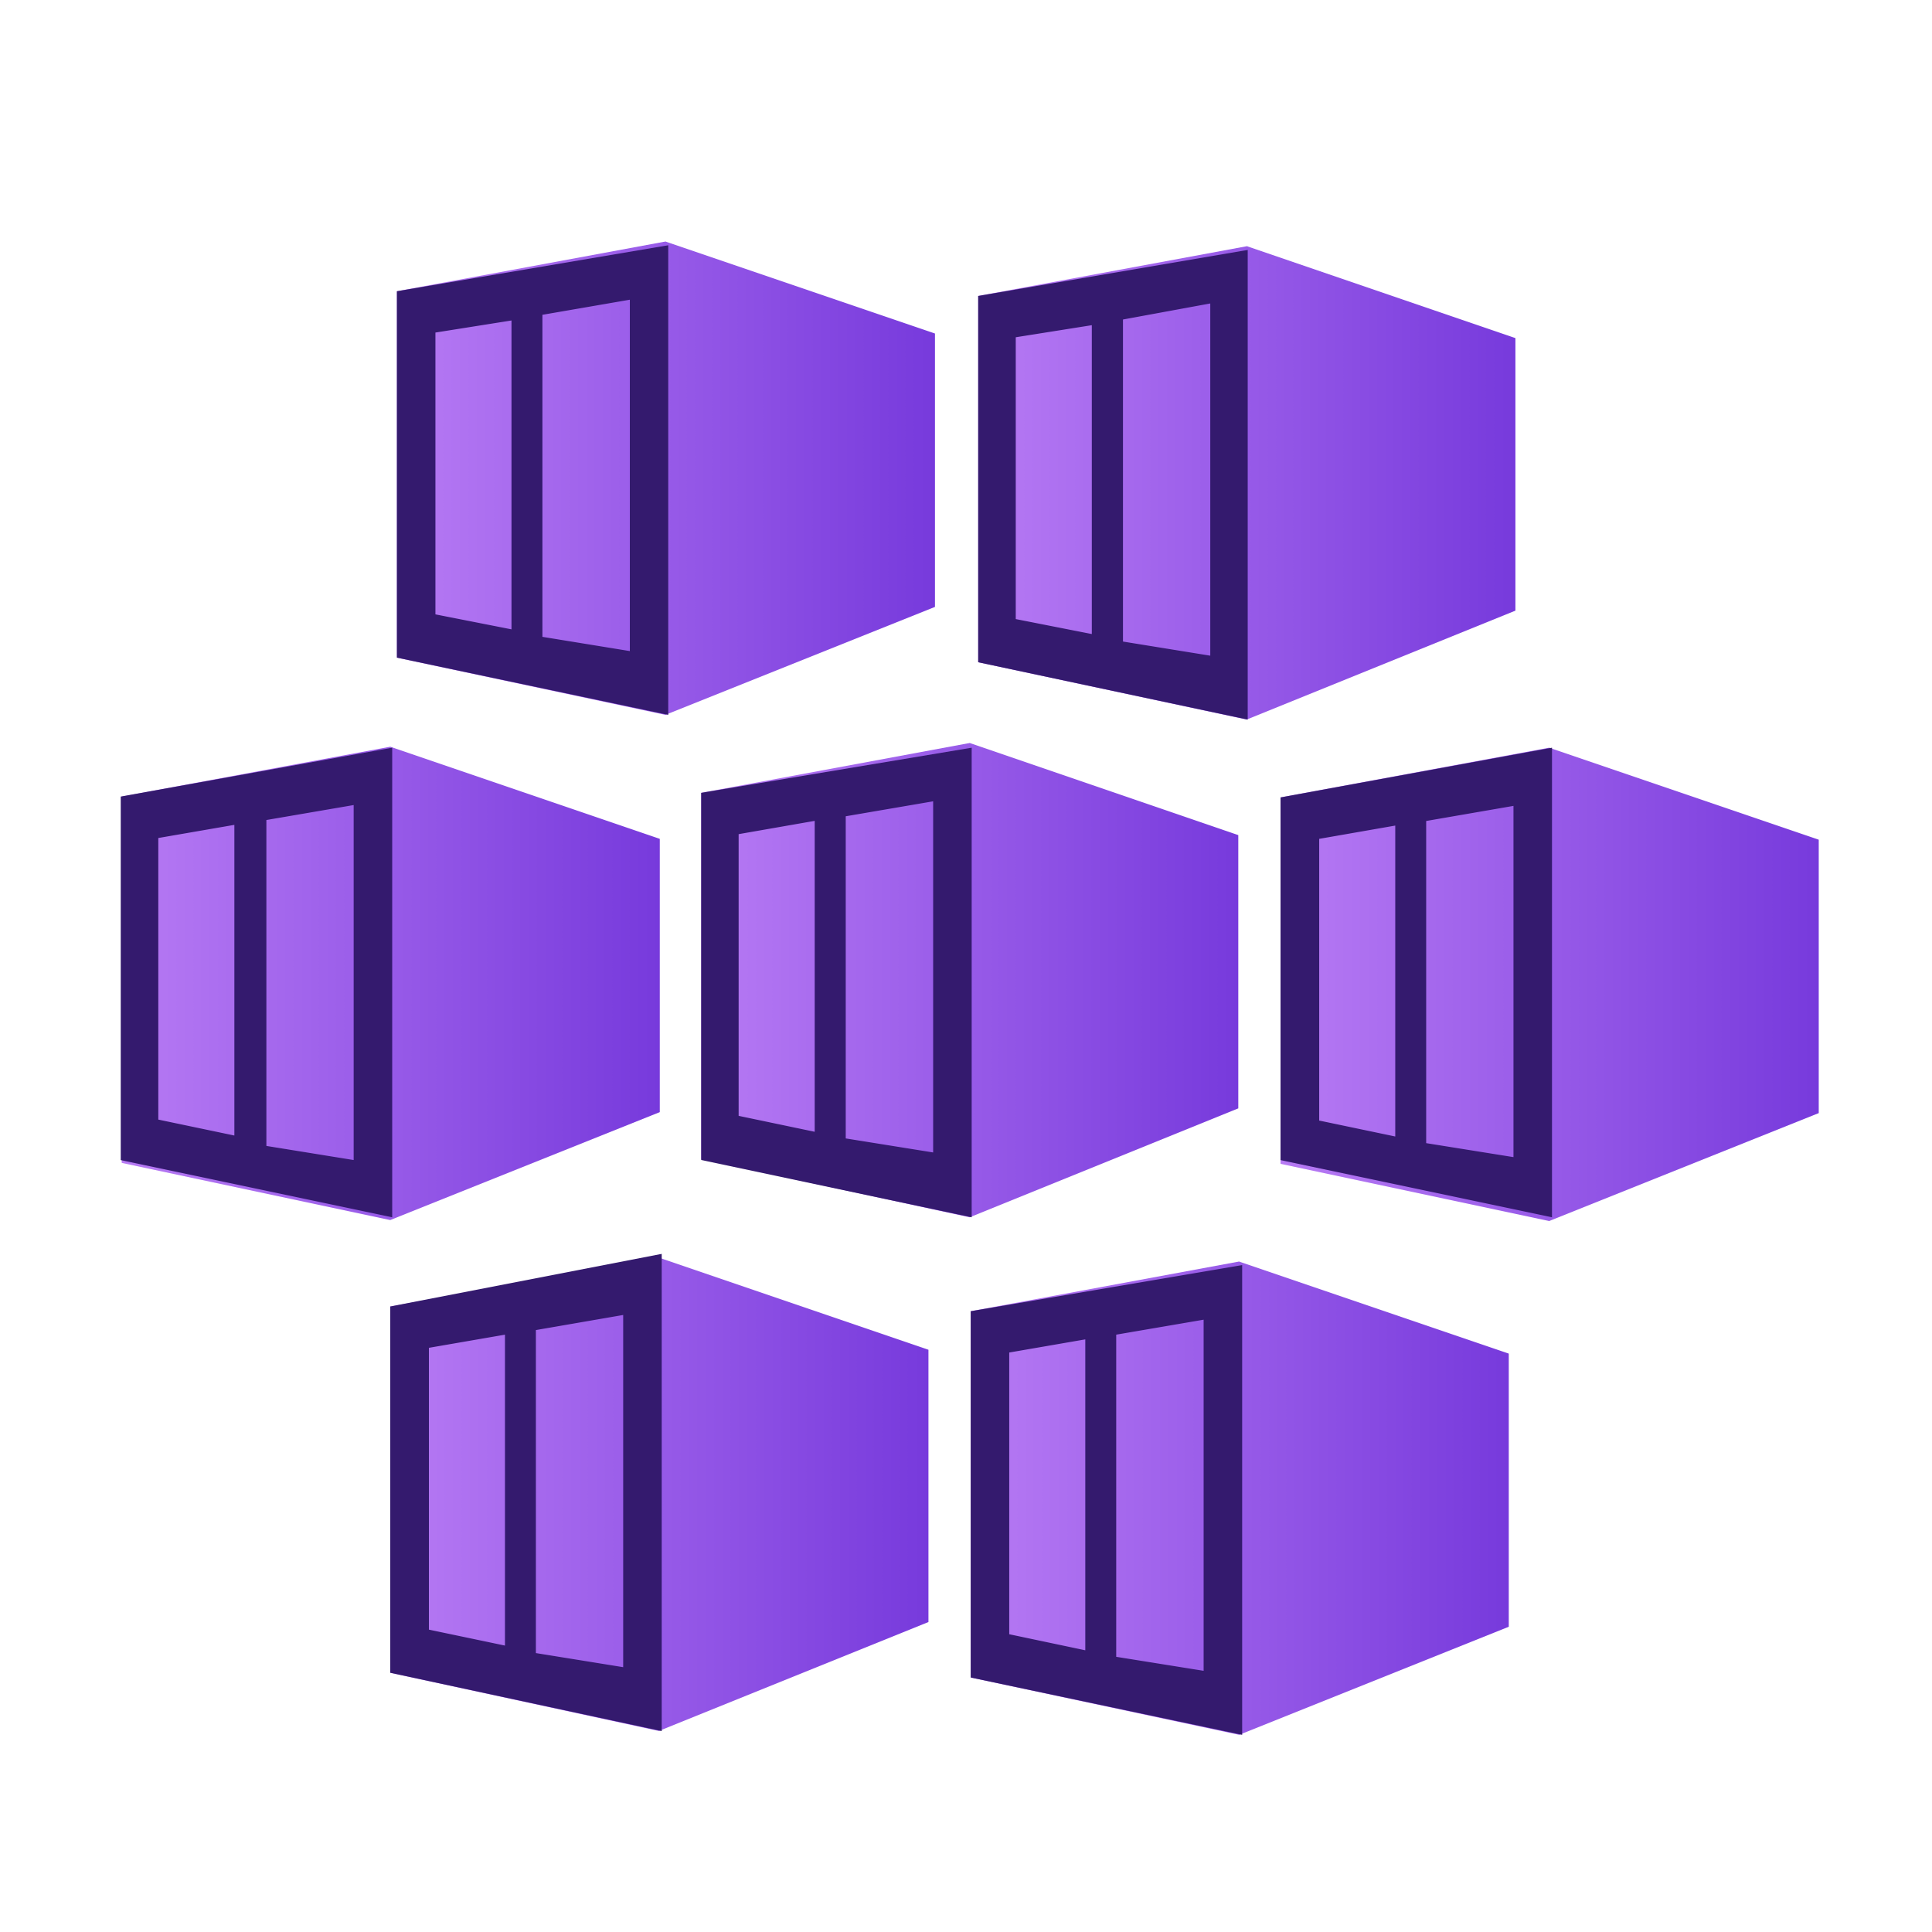



Azure Kubernetes Service
Inject 6s Delay in 1 Pod
Frontend-A
(No-Dapr)
Backend-B
Resiliency enabled
Frontend-A
(Dapr)
policies:
retries:
retryFiveTimes:
policy: constant
duration: 50ms
maxRetries: 5
Notes:
Azure Chaos Studio uses Chaos Mesh, a free, open-source chaos engineering platform for Kubernetes to inject faults into an AKS cluster.

Slide 18
var client = new HttpClient();
// 1-line change: Dapr app id as part of the header
client.DefaultRequestHeaders.Add("dapr-app-id", "order-processor");
var order = new Order(100);
var orderJson = JsonSerializer.Serialize<Order>(order);
var content = new StringContent(orderJson, Encoding.UTF8, "application/json");
// Invoking the /orders service
var response = await client.PostAsync($"{baseURL}/orders", content);
Console.WriteLine("Order passed: " + order);
public record Order([property: JsonPropertyName("orderId")] int OrderId);
Notes:
Additional language samples here, Java etc.

Slide 23
Future Roadmap
Dapr Workflow
Durable orchestrations, built with DTFx + Actors, comes with Dapr enabled integrations (100+ cross multiple clouds and still expanding)
Dapr in Functions
out-of-box solution for developers to build event-driven serverless app with Dapr + KEDA enabled ACA/AKS/….
Azure Container Apps “Powered by Dapr”
App networking features built in like mTLS, Certificate Authority, and resiliency
AI Bindings
Bindings that make it easy to work with Open AI, ChatGPT, LangChain, memories, and more
Multi-microservice run and debug
Run all microservices at once, and F5 in Visual Studio
Pluggable Components
bring your own component to Dapr in any language, any arch

Slide 24
Appendix

